Slide 1
Consumer Flow- American Heritage

Slide 2
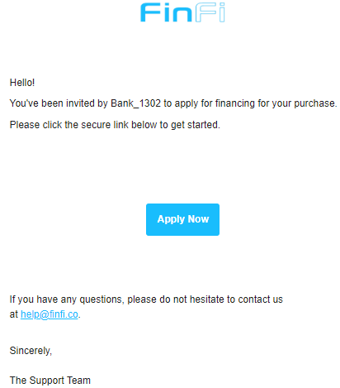
Customer receives an email from help@finfi.com
Consumer clicks on “Apply Now”

Slide 3
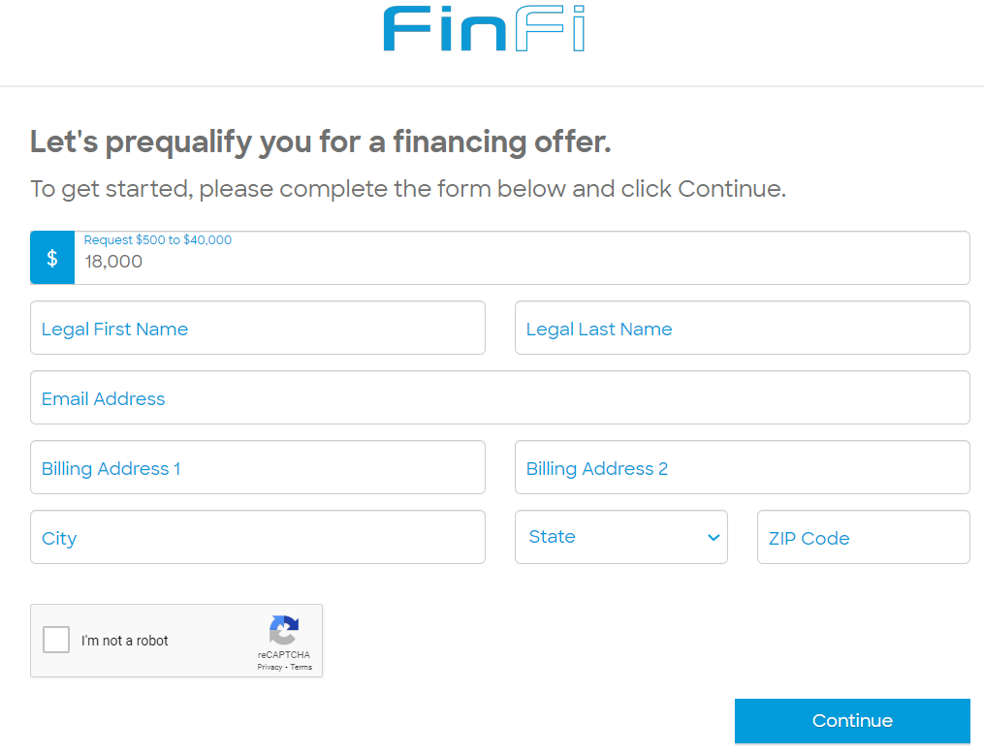
Billing Information
All fields are to be filled:
Requested loan amount (this can be edited at this time)
Legal First Name
Legal Last Name
Email Address
Billing Address
Information provided should match the customer. A mismatch can trigger a fraud alert and may delay funding or cause the application to pend.

Slide 4
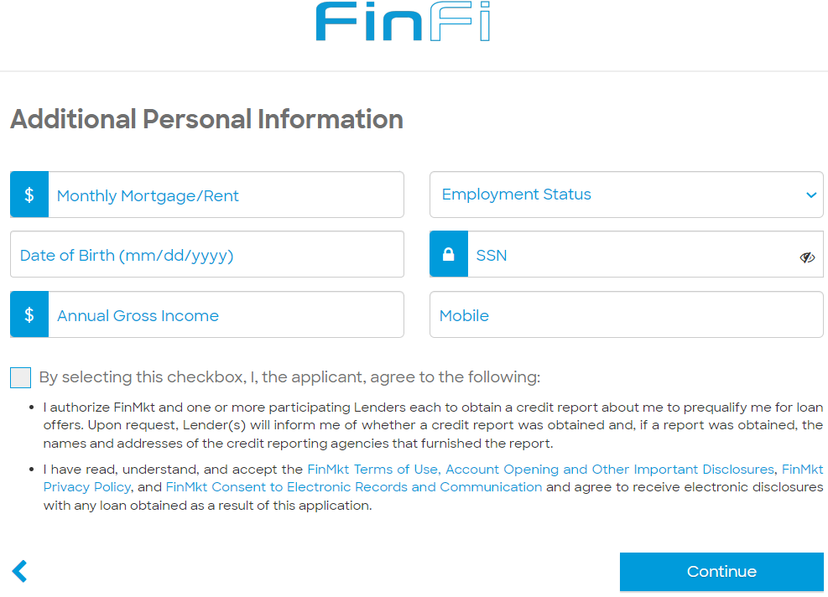
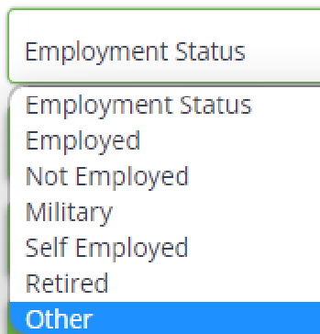
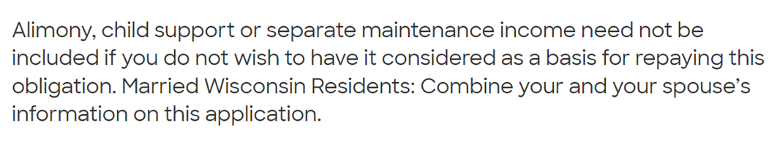
Additional Personal Information
Required Personal Information:
Monthly Mortgage/Rent – The Amount consumer commits as EMIs on monthly basis.
Employment Status - Choose one of the employment options listed.
Date of Birth
Social Security Number
Annual Gross Income – Total Amount that a consumer earns in a year
Mobile Number

Slide 5
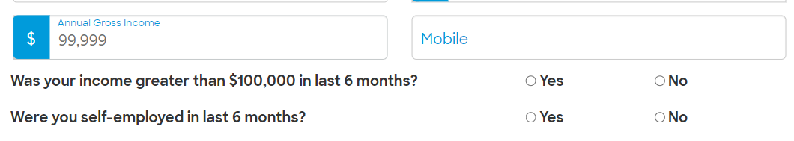
If the Annual Income is less than $100,000
If the annual income of the consumer is less than $100,000, consumer would need to submit additional documents requested by the lender.

Slide 6
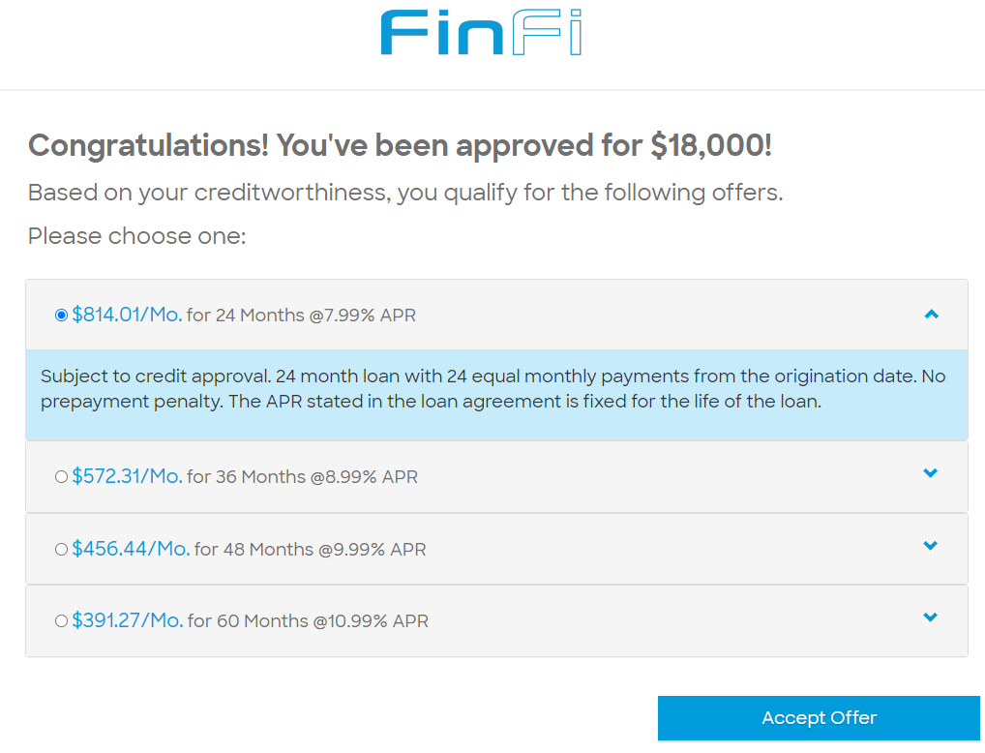
Consumer chooses the offer
Receives different offers:
Offers are presented based on a soft credit pull.
Soft Pull: It is an inquiry into your Credit Report to check the eligibility for the loan. It allows a creditor to review your credit report and credit score to get a sense of how well you are managing your credit. Credit Score does not get impacted.
Customers can click on an offer to view details of the terms
After clicking “Accept Offer,” the customer will be asked to confirm their loan selection.

Slide 7
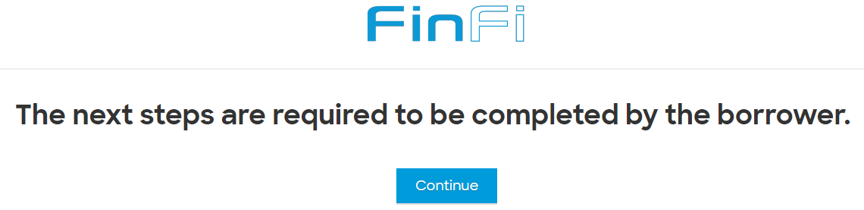
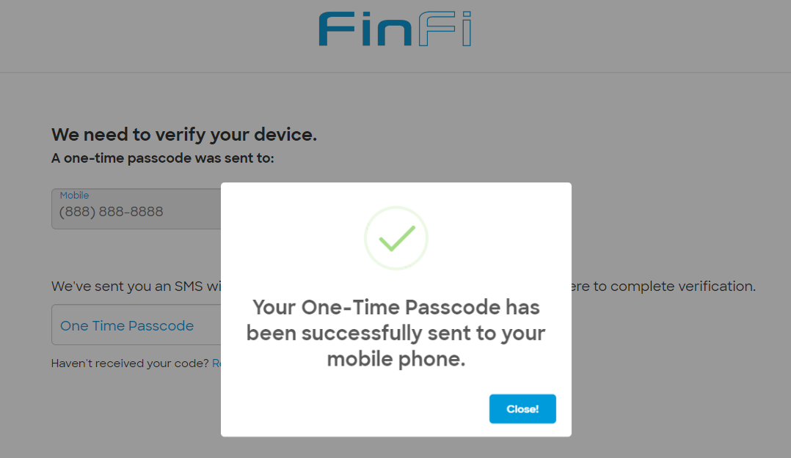
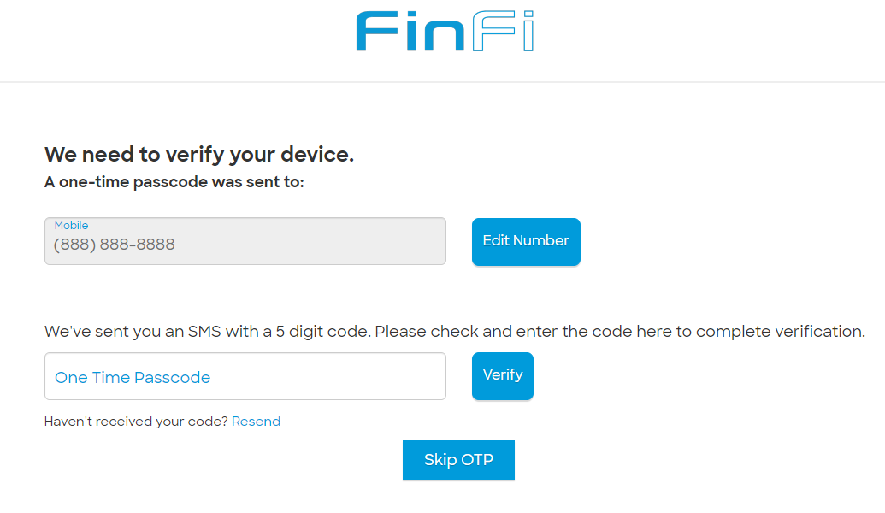
Verify Device
After clicking ‘continue’.
Consumer receives an OTP for verification.
Consumer fills the OTP and clicks on verify.

Slide 8
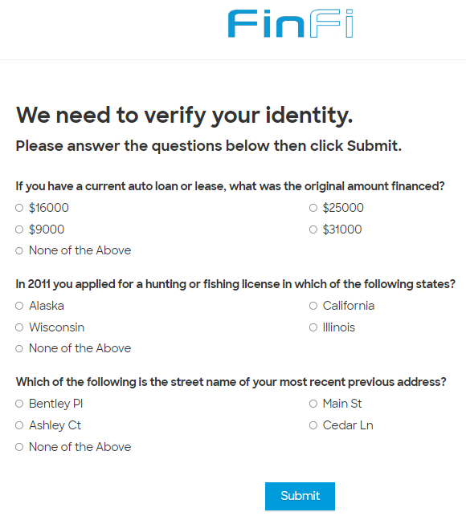
If consumer skips OTP, consumer has to complete this verification.
These questions need to be answered by the consumer if the he skips the OTP. This is very important for the lender to identify the consumer’s credibility.
Answering these questions wrong will lead the application to ‘Pend’ state.

Slide 9
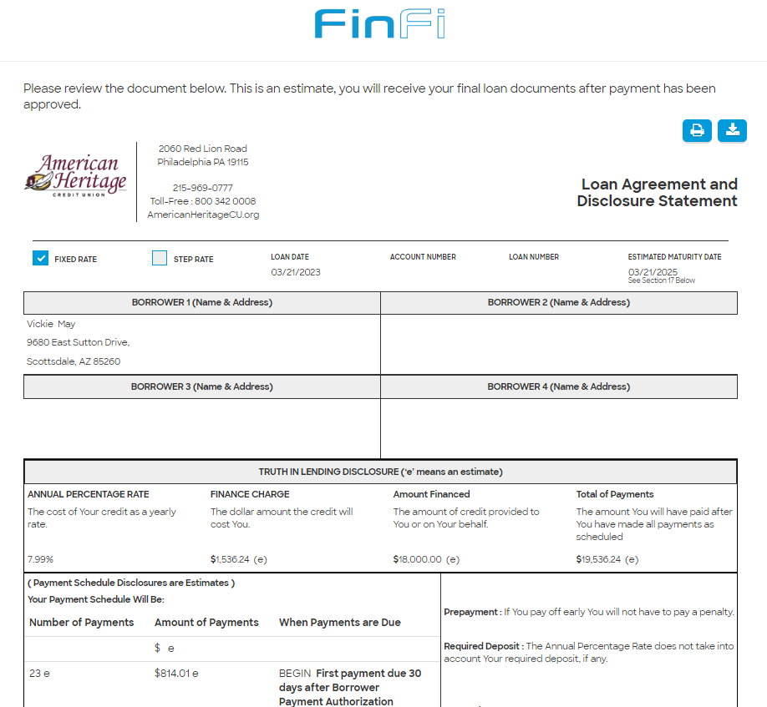
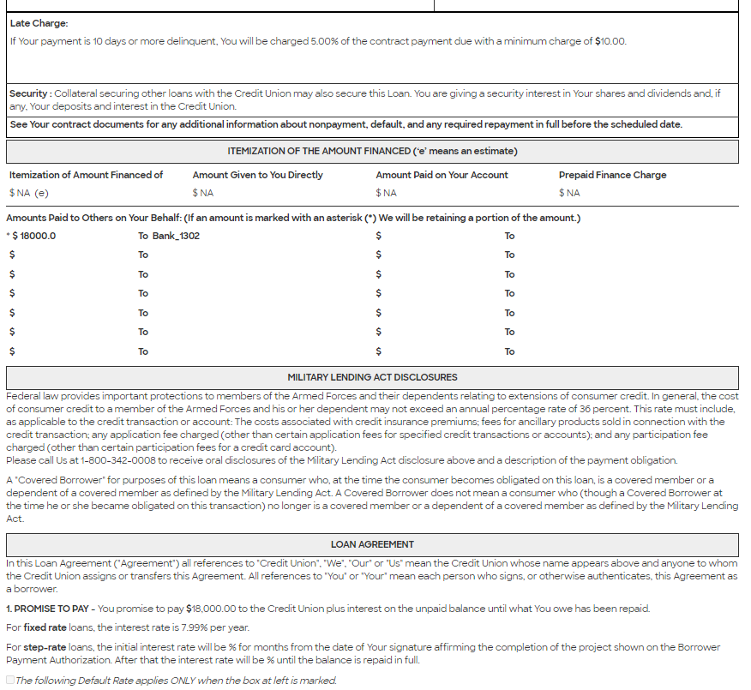
Estimate Loan Agreement Document

Slide 10
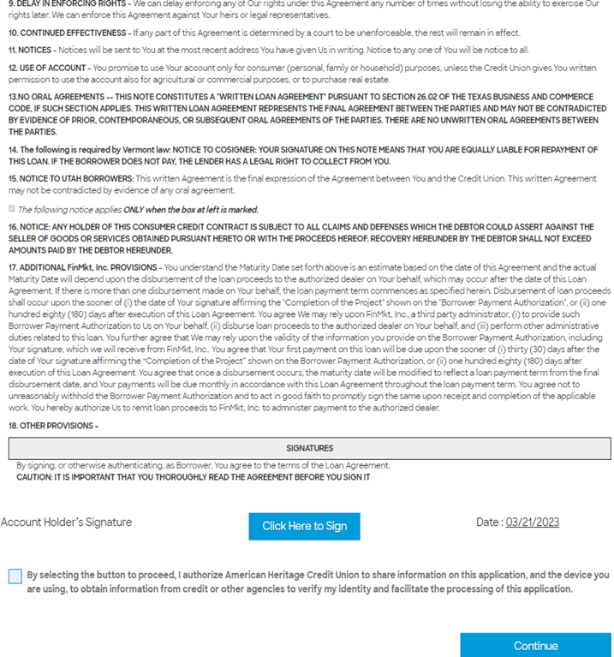
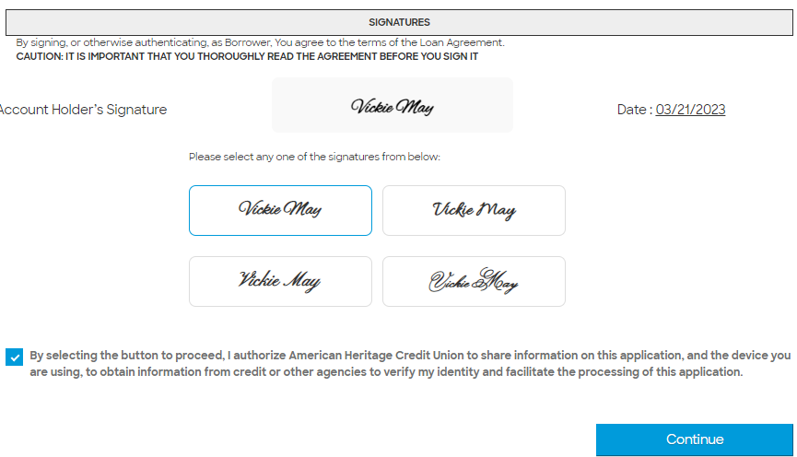

Slide 11
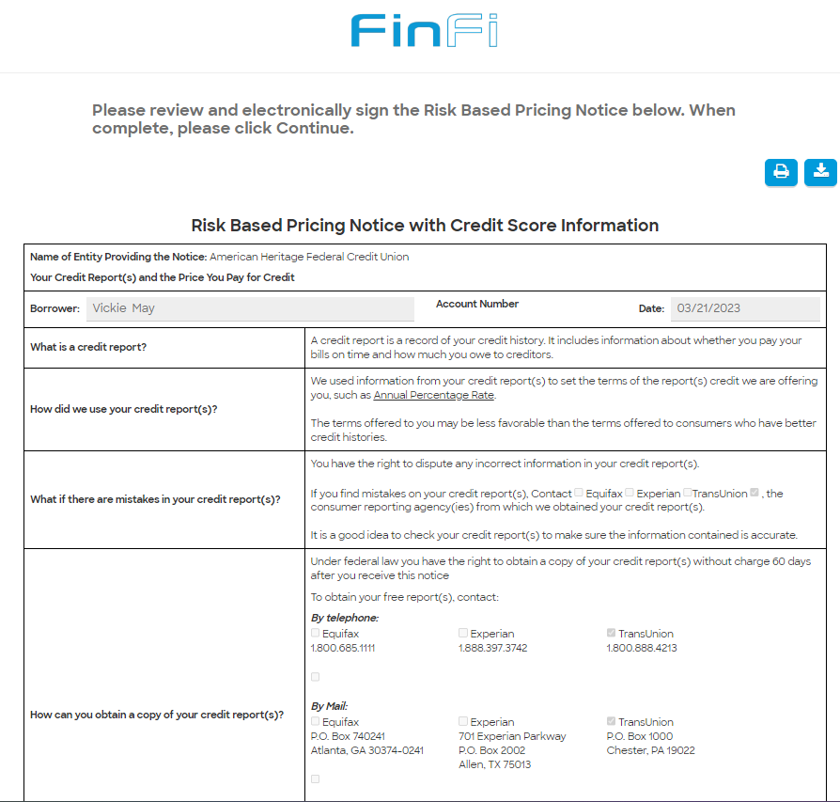
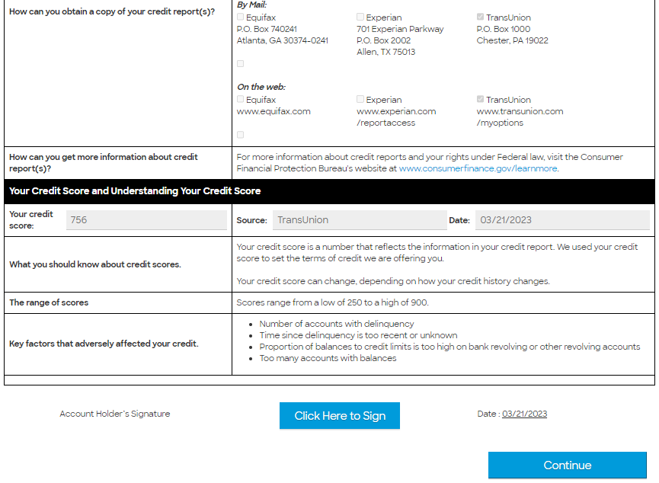

Risk Based Pricing Notice

Slide 12
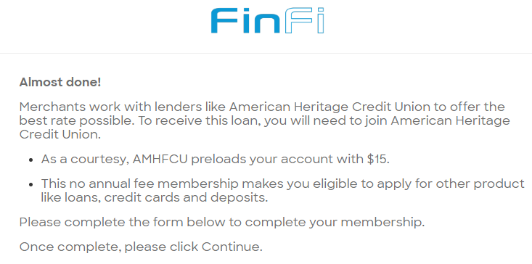
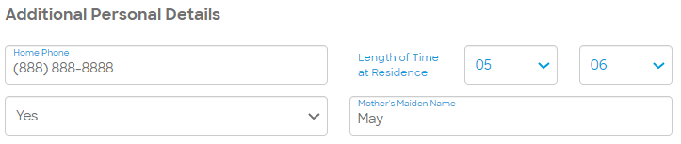
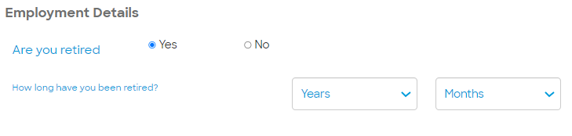
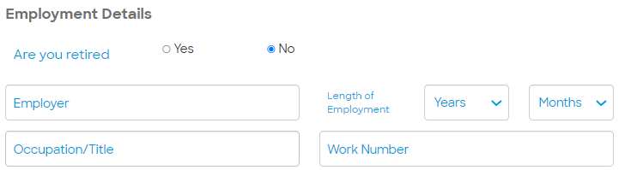
Memberize with AMH Credit Union
Credit unions requests the consumers to be the members of their Credit Union to provide loans and offers at the best rate possible.

Slide 13
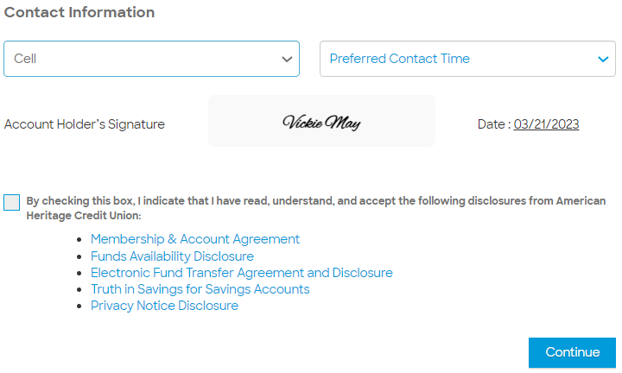
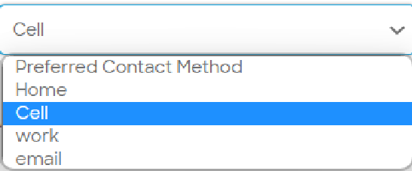
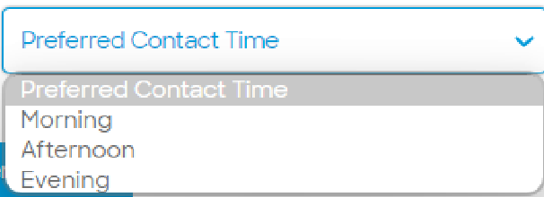
Contact Information
Consumer needs to confirm the preferred mode of contact and time to contact.

Slide 14
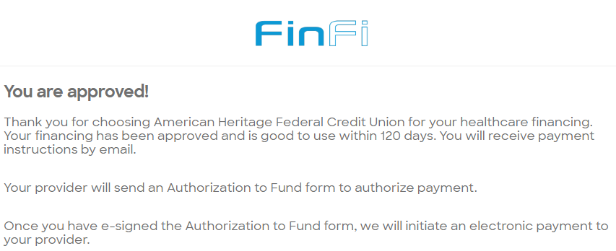
Loan is approved and ‘Thank you’ email sent

Slide 15
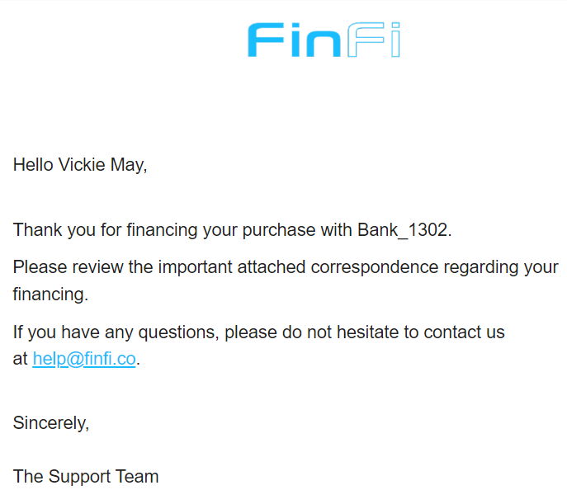
Thank you email sent to the consumer.

Slide 16
Request Payment

Slide 17
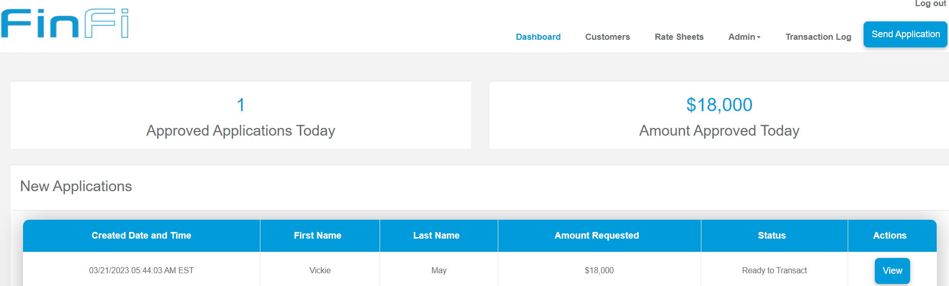
Ready to Transact

Slide 18
Request Payment

Slide 19
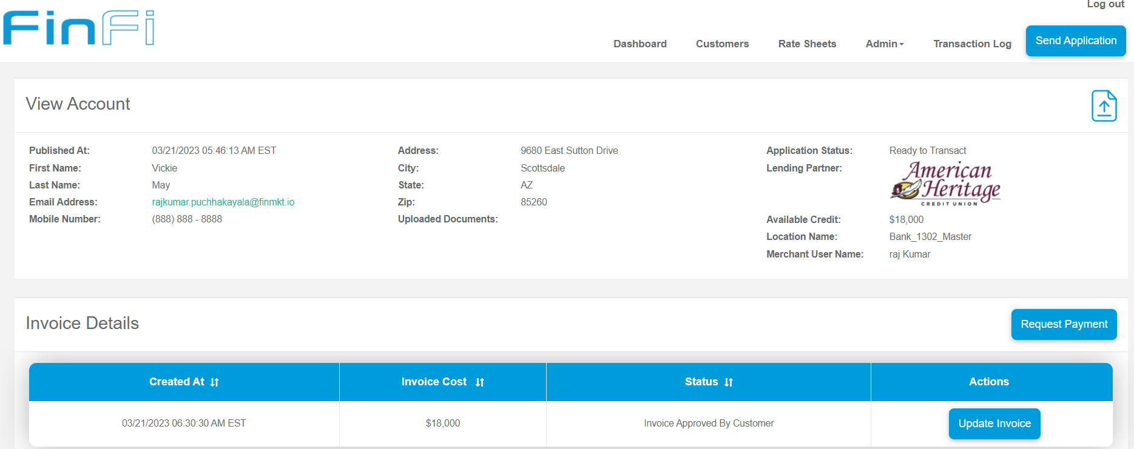
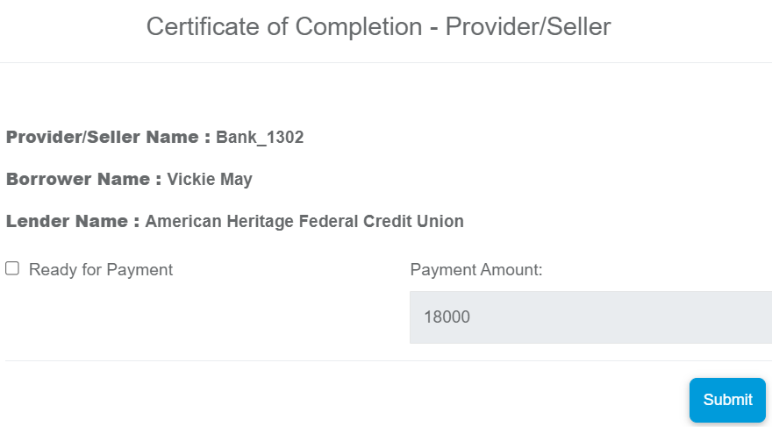
Request Payment
Merchant can update the invoice amount at this stage as well.

Slide 20
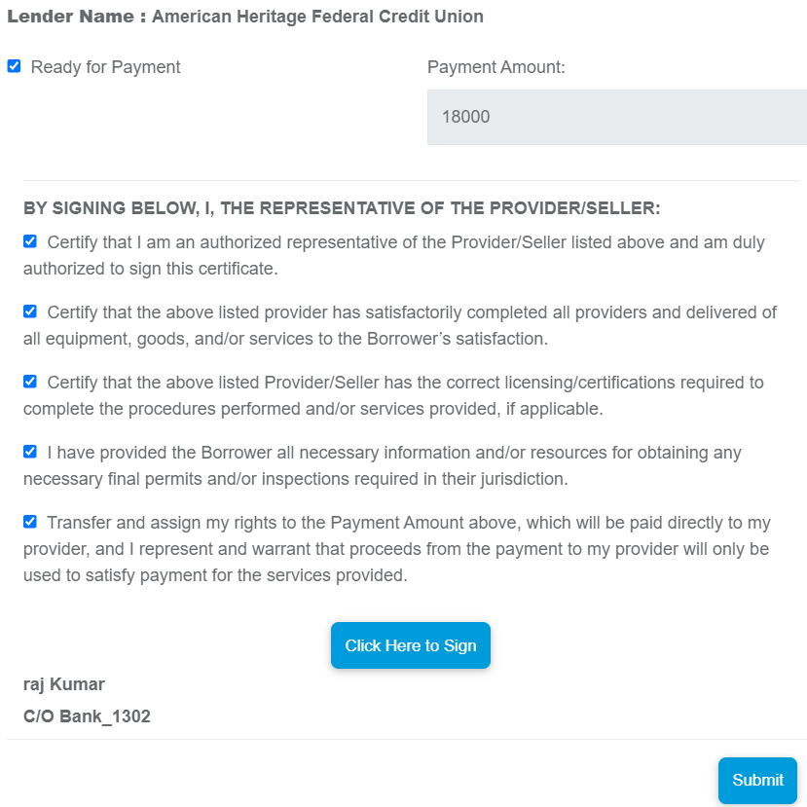
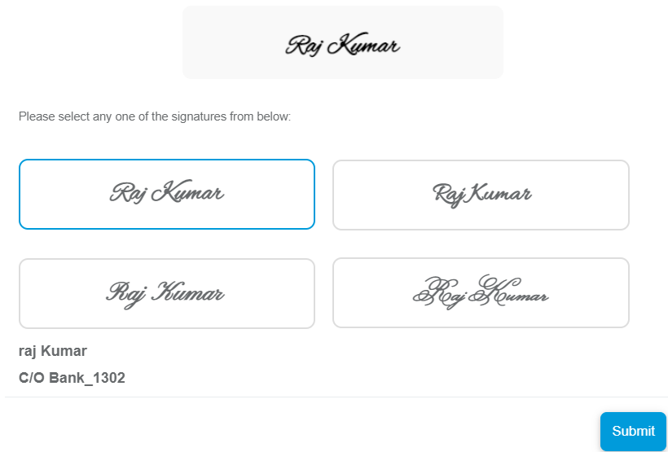
Authorizing the Fund
Only if the consumer ticks the check box will he see the other points to read carefully and certify. Then consumer signs.

Slide 21
BY SIGNING BELOW, I, THE REPRESENTATIVE OF THE CONTRACTOR/SELLER:
Certify that I am an authorized representative of the Contractor/Seller listed above and am duly authorized to sign this certificate.
Certify that the above listed Contractor has satisfactorily delivered of all equipment, goods, and/or services, and any installation included in the project has been successfully completed to the Borrower’s satisfaction.
Certify that the above listed Contractor/Seller has the all required licensing and classifications to install the products and/or equipment on the Borrower’s property.
I have provided the Borrower all necessary information and/or resources to obtain any necessary final permits and/or inspections required in their jurisdiction.
Certify that the Contractor/Seller shall defend and indemnify Lender against and hold Lender harmless from and against all claims, actions, costs, expenses, losses, and damages, including attorneys’ fees, arising out of or connected with any claim, whether well founded, baseless or otherwise, relating in any way to the goods and services provided by Contractor/Seller.
Certify that proceeds from the payment will only be used to satisfy payment for the services provided.

Slide 22
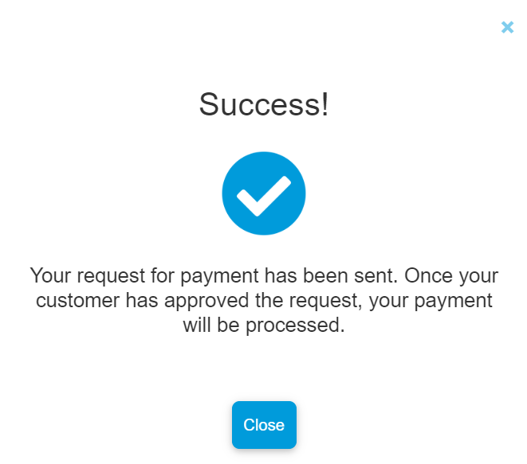
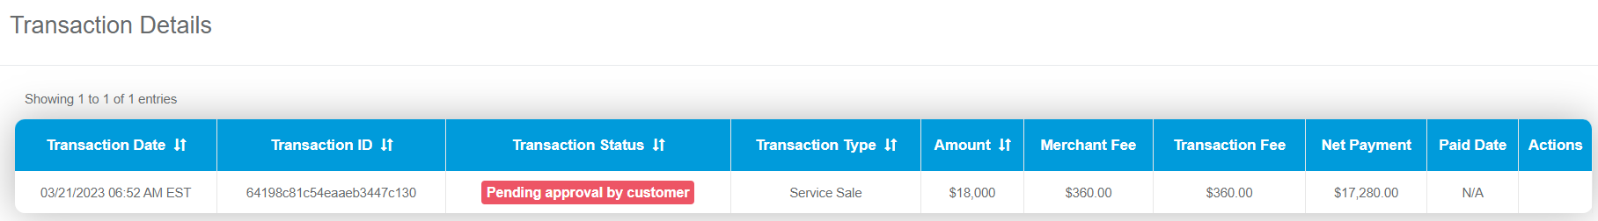
Consumer has to approve the payment

Slide 23
Certificate of Completion by the Borrower

Slide 24
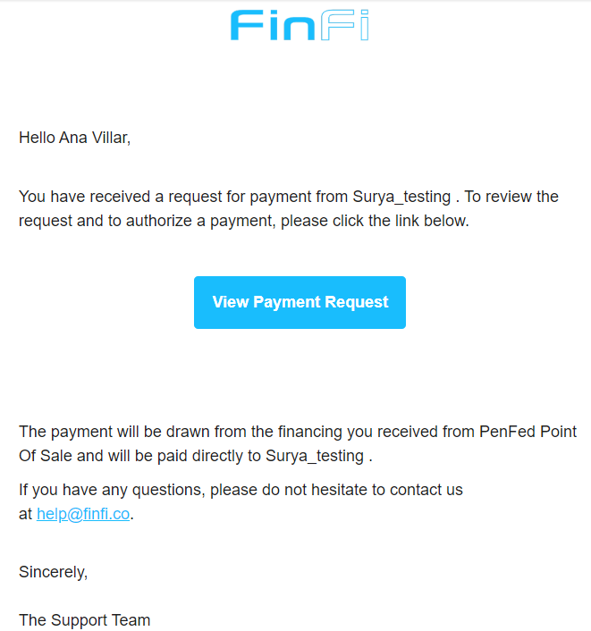
Consumer receives an email for a payment approval.

Slide 25
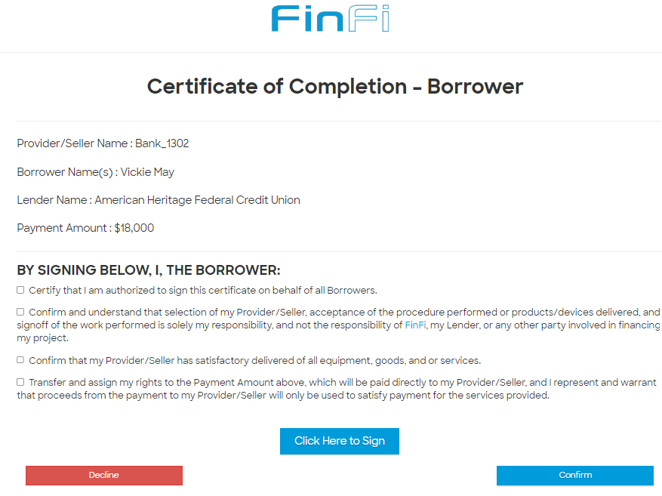

Consumer needs to certify the completion of the project
Consumer has to sign the document confirming the completion of the entire work. Without this step, Merchant will not get paid. If consumer declines here the payment will not done.

Slide 26
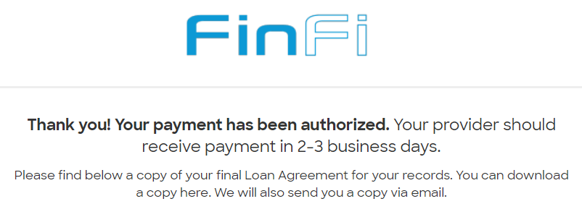
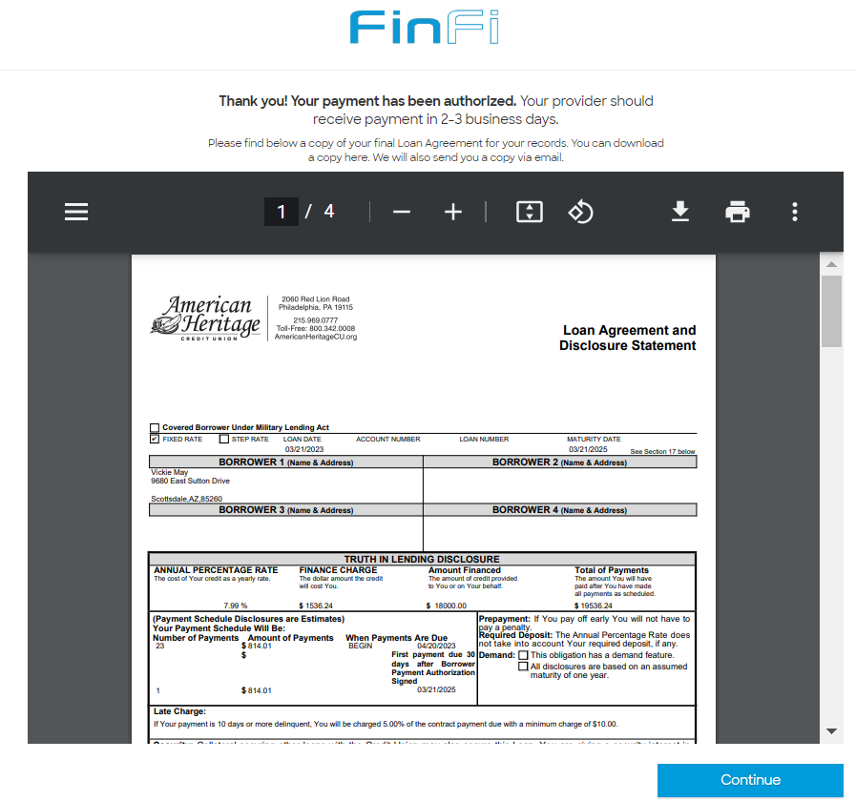
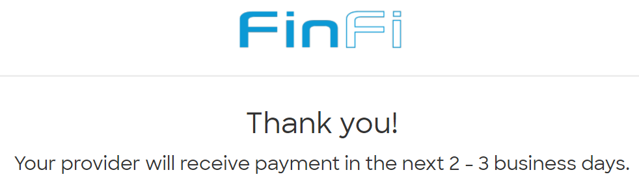
TILA
After clicking ‘Continue’ there will be a Thank you page.
Notes:
The escrow agreement is a financial agreement in which a third party holds the financial payment between two parties. A third party is an independent person who holds the funds to ensure the security of the transaction.

Slide 27
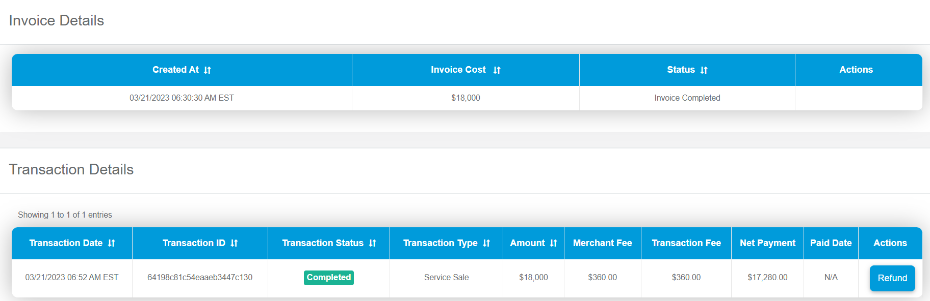
Application status changes in ‘Merchant Portal’

Slide 28
Thank You!

